Slide 1
THE FINE (QUEER) ART OF ASKING
FOR (AND RECEIVING) ASSISTANCE
KELLI DUNHAM

Slide 4
WHY DOES IT MATTER?

Slide 11
THE BARRIERS

Slide 13
AHEM.
CAPITALISM.
AHEM.

Slide 14
OR
GET
A TON
OF
UNSOLICITED
ADVICE

Slide 17
AHEM.
CAPITALISM.
AHEM.

Slide 19
AHEM.
CAPITALISM.
AHEM.

Slide 20
(AS AN ASKER OR AN ASKEE)

Slide 22
AHEM.
CAPITALISM.
AHEM.

Slide 24
THINGS TO REMEMBER

Slide 27
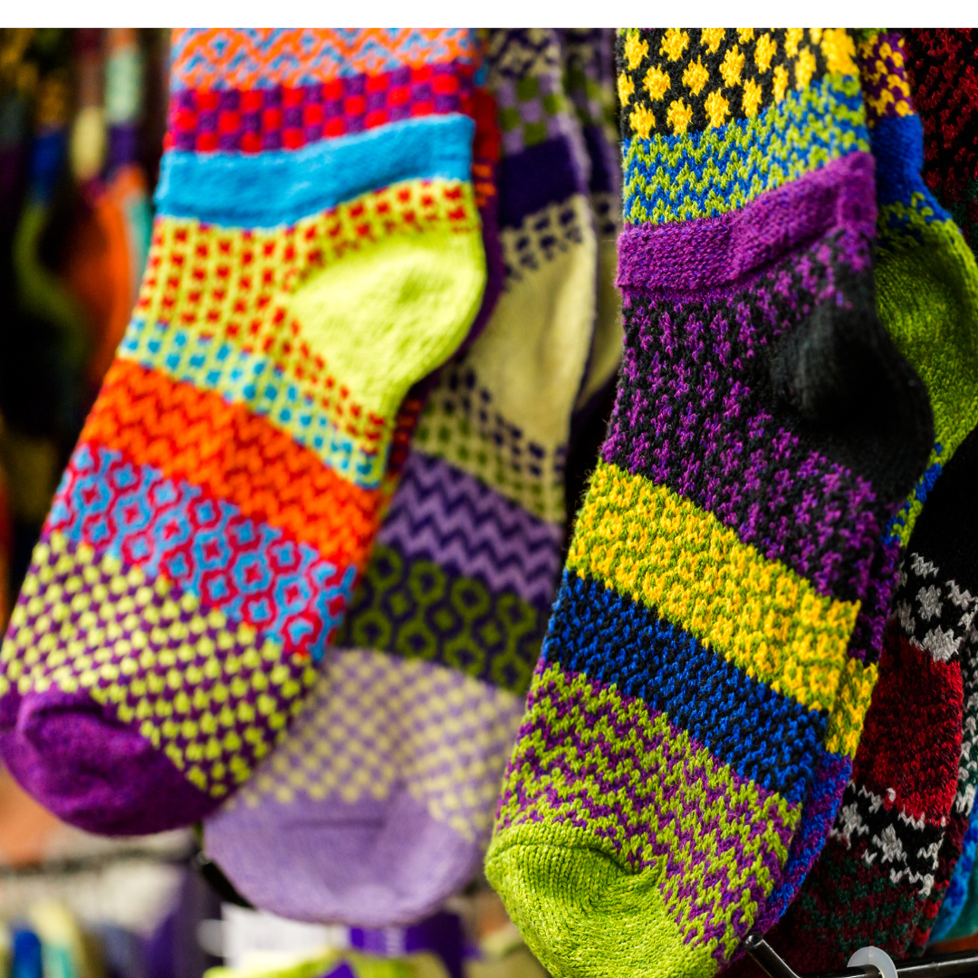

Slide 33
HOW
TO DO IT-
NUTS N BOLTS

Slide 41
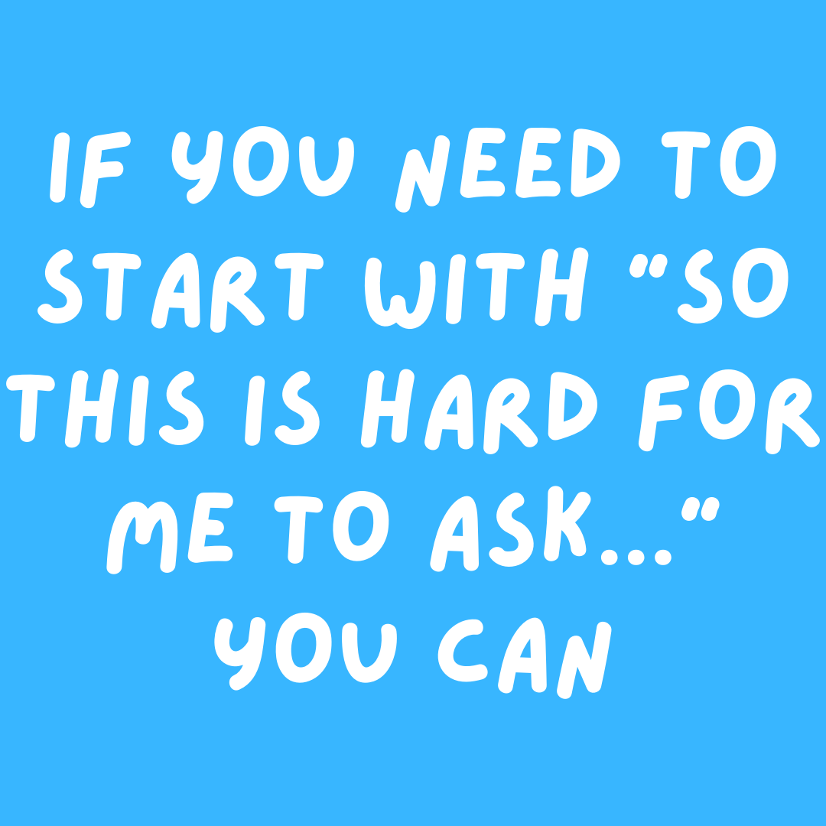

Slide 55
RESOURCES
http://www.kellidunham.com/resources-on-accepting-help/

