Slide 1
GRIEF. YOU’RE
NOT DOING IT WRONG
PHILLY TRANS WELLNESS JULY 2021
KELLI DUNHAM

Slide 6
GRIEF
MYTHS/
TRUTHS

Slide 7
POP CULTURE IS THE WORST

Slide 9
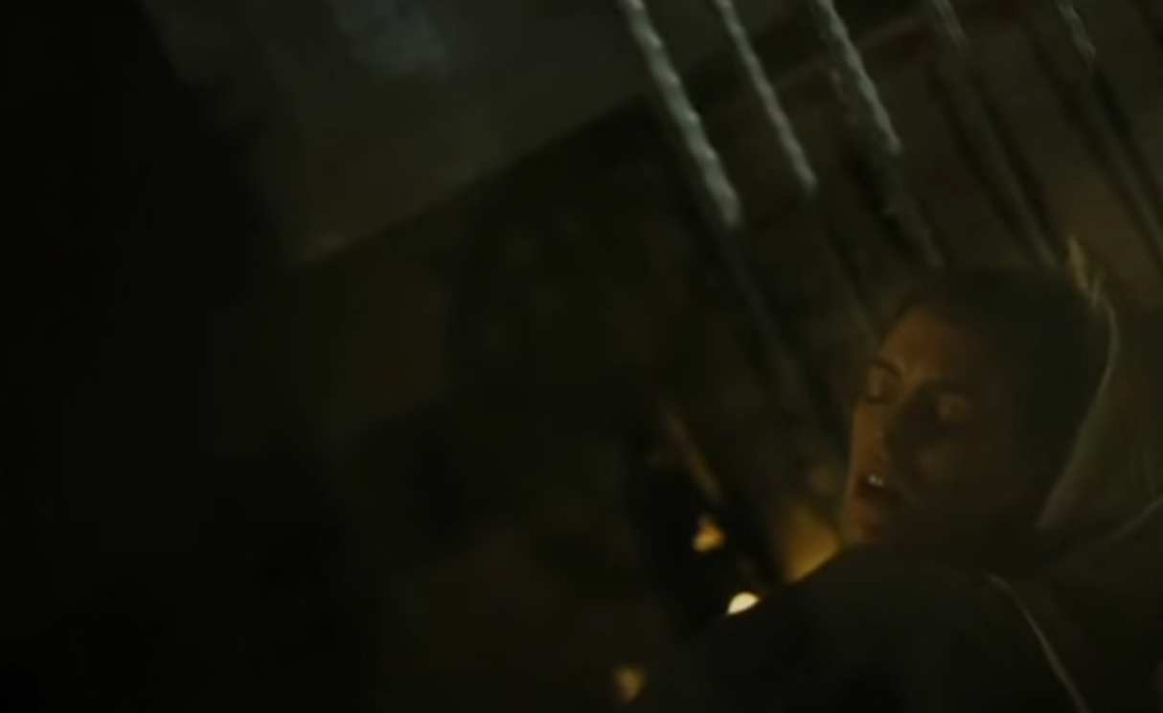
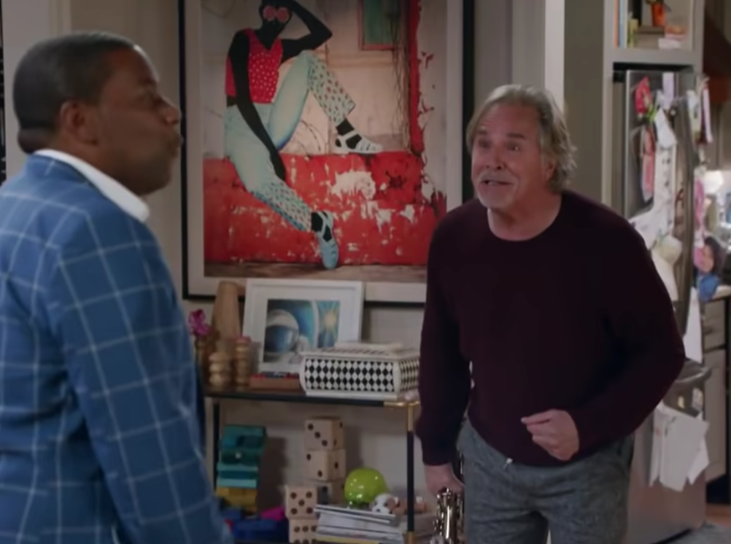

Slide 11
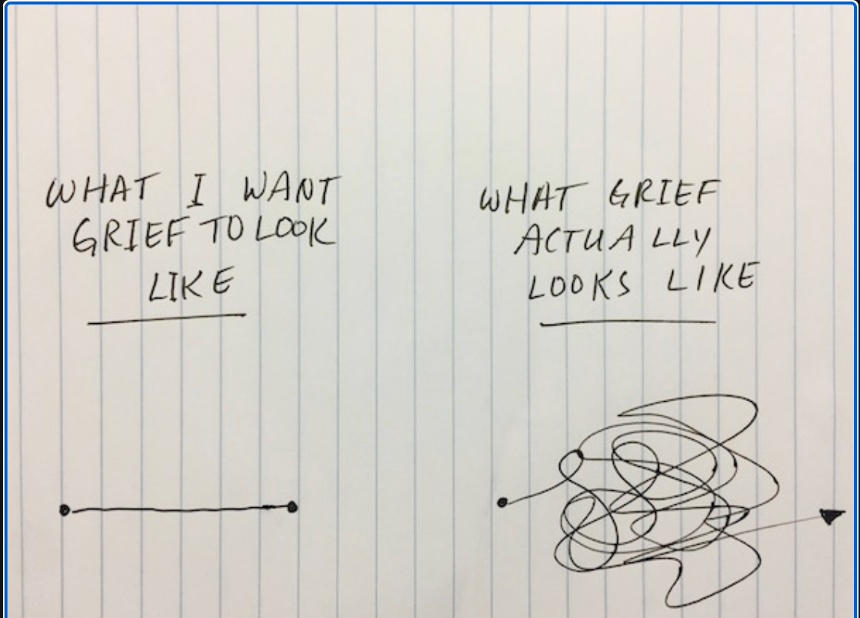

Slide 21
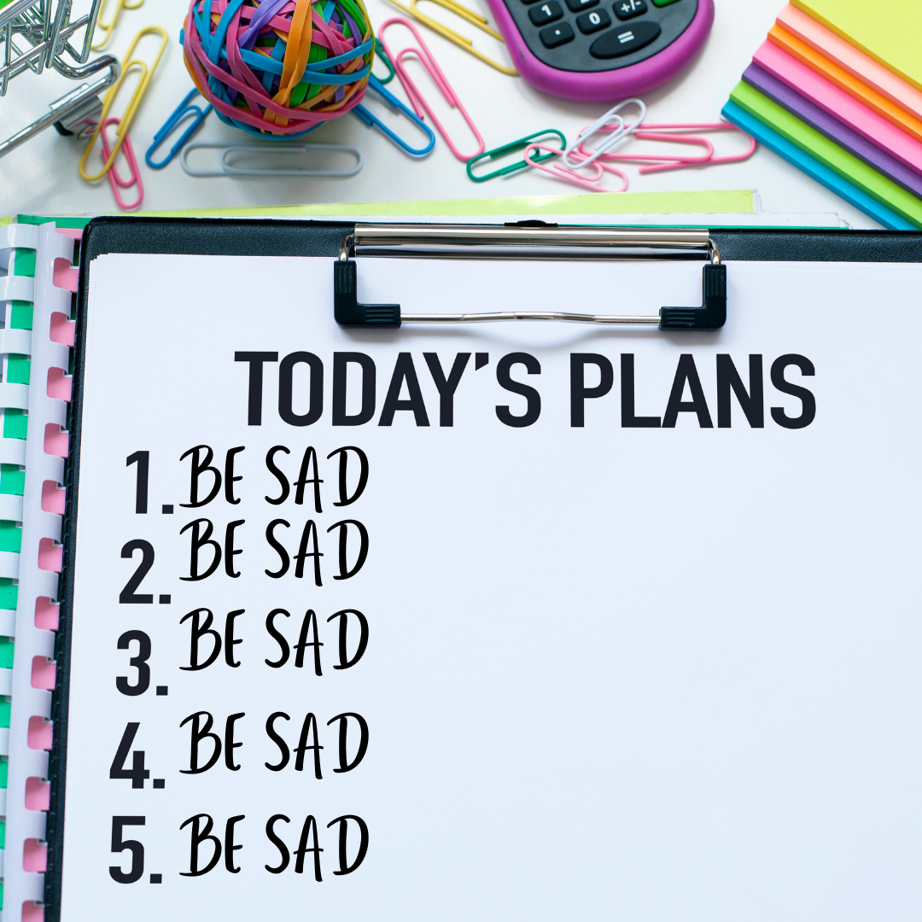

Slide 29
HOW IS TRANS/GNC GRIEF DIFFERENT?

Slide 36
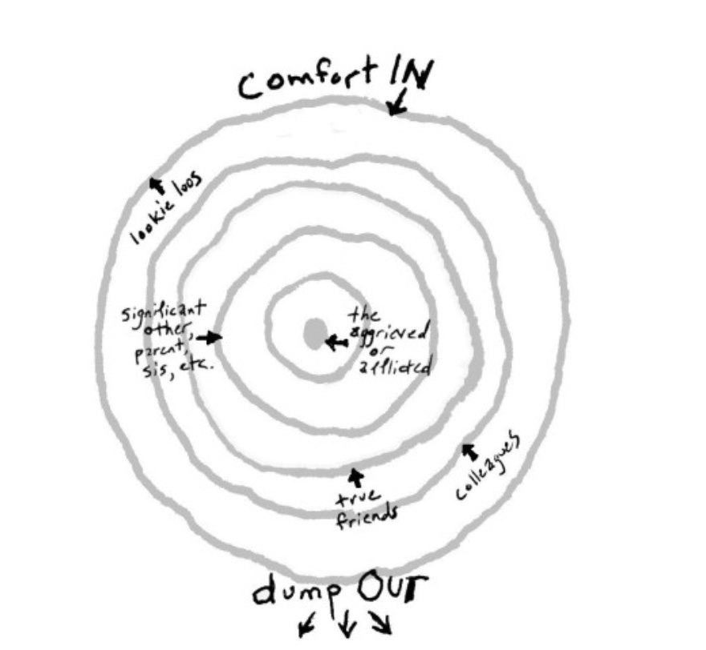

Slide 37
How do use this process in a
A DEPLETED COMMUNITY…

Slide 39
THINK BACK
TO
THE YEARBOOK

Slide 40
MOST LIKELY TO
BE A GOOD LISTENER
HELP YOU PACK UP
HELP PLAN A MEMORIAL SERVICE…

Slide 41
WHAT TOOLS DO WE HAVE?

Slide 42
Grief is madness--ask anyone who's been there. They will tell you it abates
with time, but that's a lie. What drowns you in the first year is a force
of solitude and helplessness exactly equal in intensity to the love you had
for the one who's gone. Equally passionate, equally intimate.
The spaces between
the stabs of pain grow longer after a while, but they're empty spaces. The
cliches of condolence get you back to the office,
back to your taxes and the dinner
table--and for everyone else's sake, you collaborate. The road of least
resistance is paved with the gravel of well-meaning friends,
rather like the gravel that cremation leaves.
Paul Monette, Last Watch of the Night

Slide 43
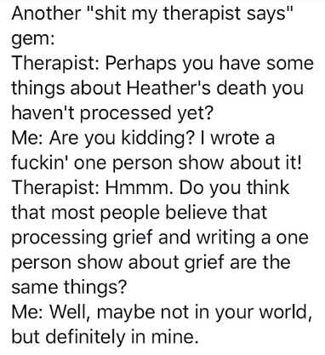

Slide 44
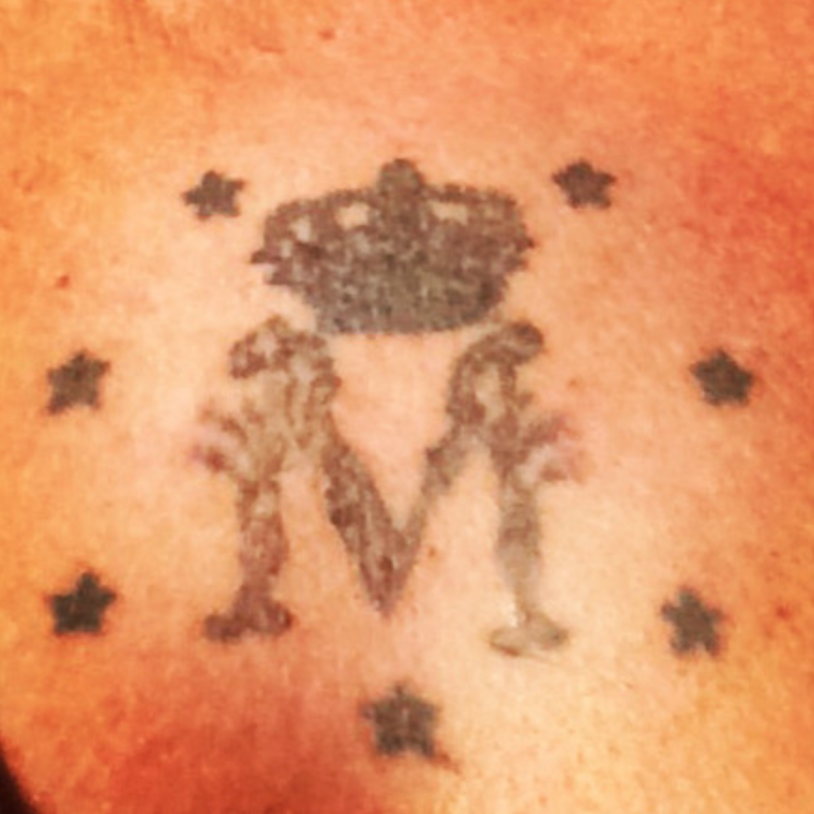
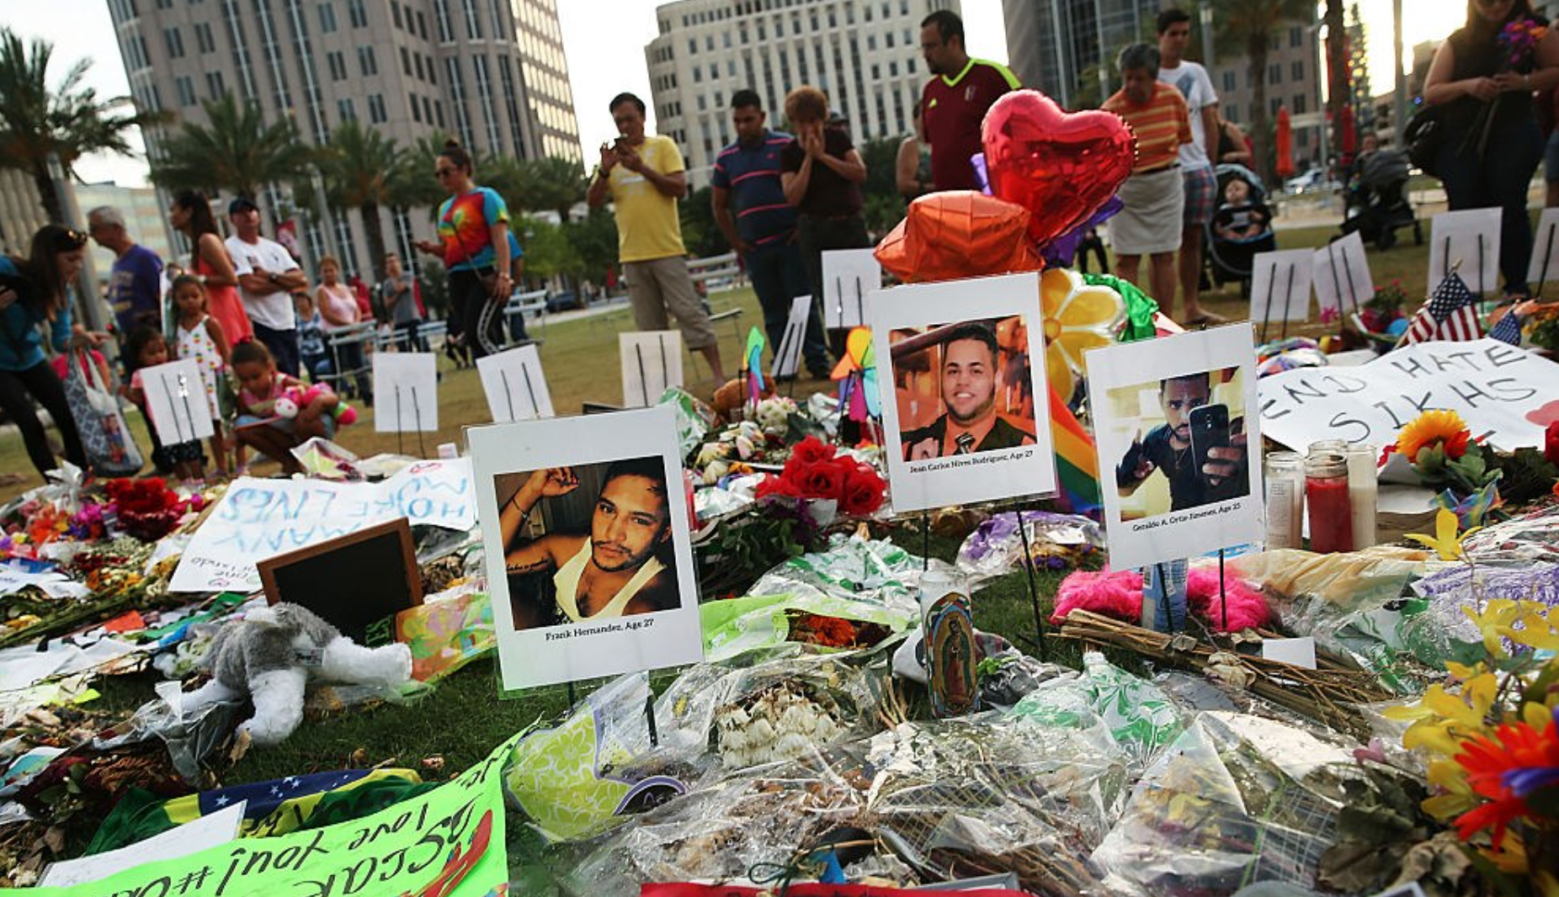

Slide 45
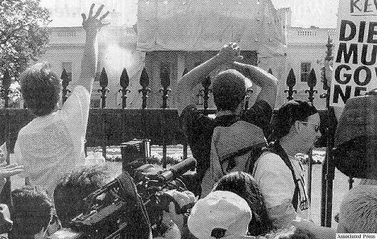

Slide 46
WHAT TIPS AND TOOLS DO WE NEED?

Slide 47
TIPS and TOOLS
(They work for some people, they might not work for you)

Slide 49
EARLY GRIEF

Slide 55
ONGOING GRIEF

Slide 62
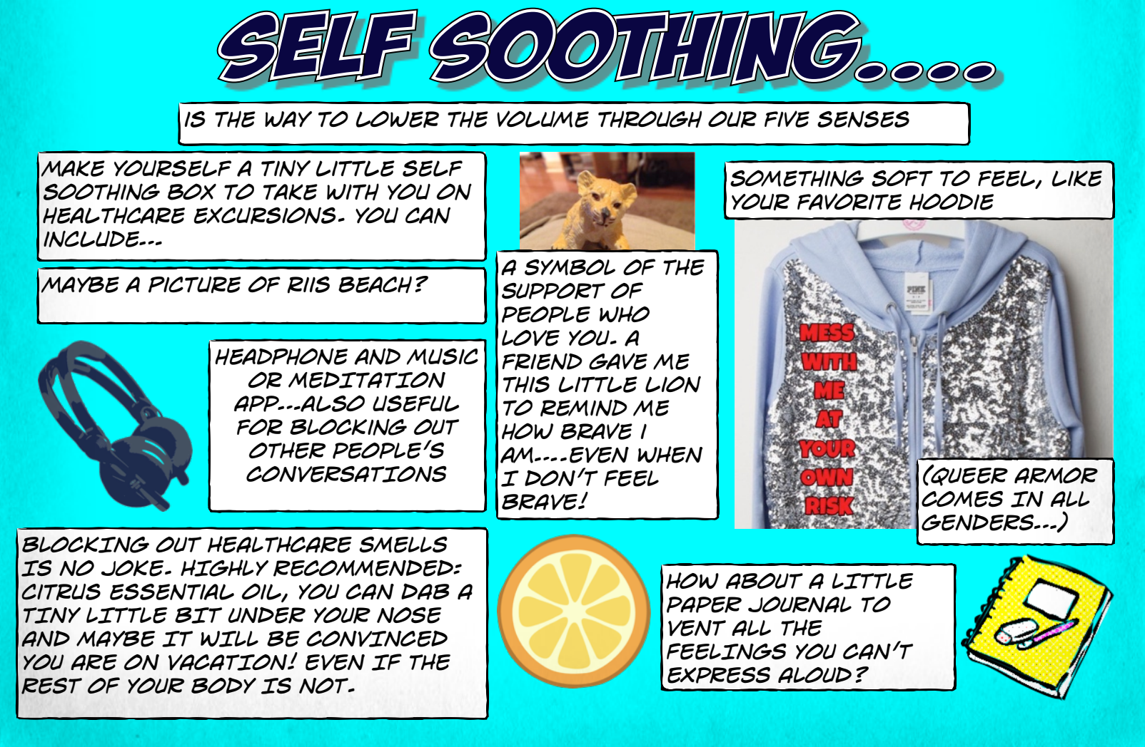

Slide 64
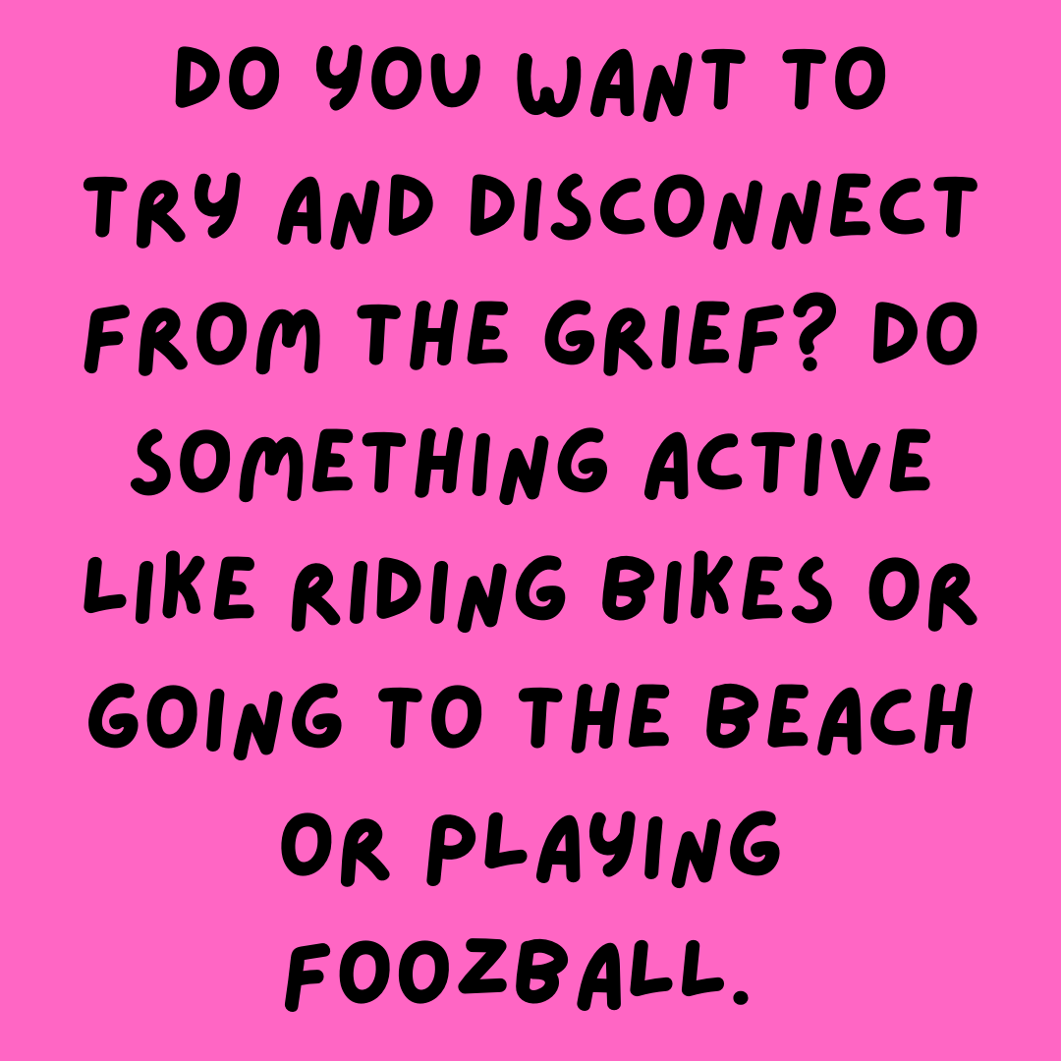

Slide 72
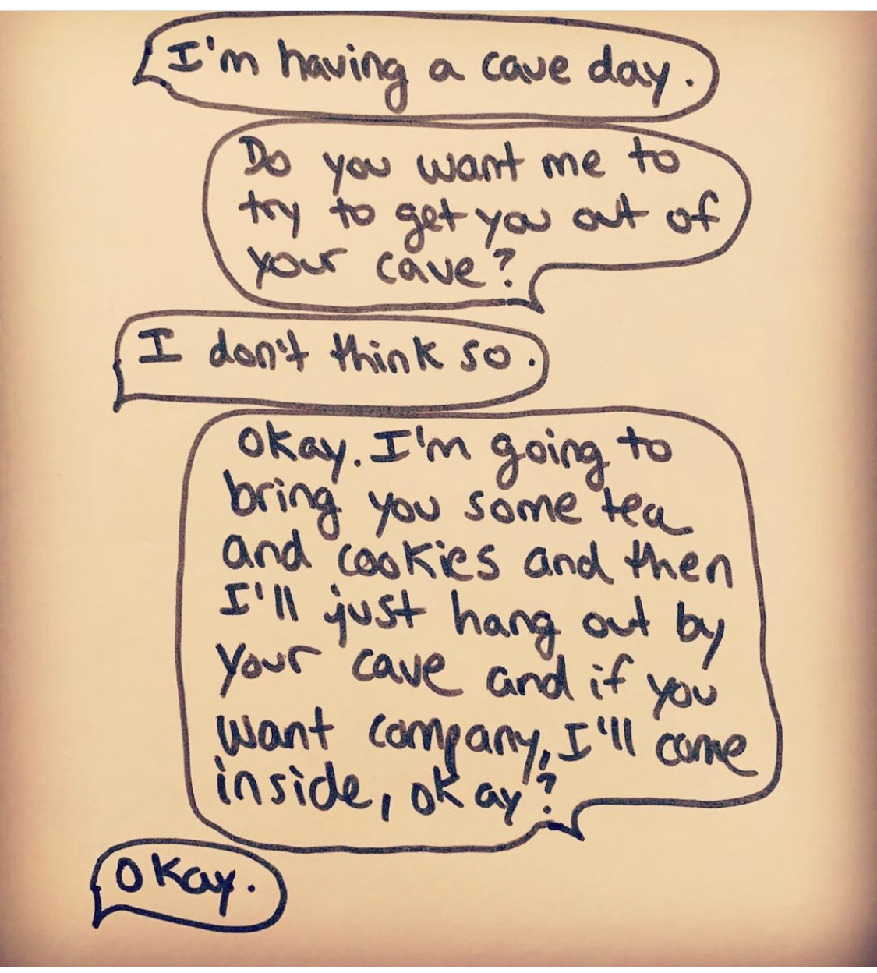
@SKETCHESFROMTHECAVE

Slide 77
Grief sucks.
Sometimes a happy ending is survival

Slide 78
KELLIDUNHAM.COM FOR MORE RESOURCES
KELLIDUNHAM@GMAIL.COM
215.964.1963

